Slide 1

SpaceX Falcon 9 First Stage Landing Prediction
Capstone Project IBM Data Scientist Certification
Published by Muhammad Ilham Rizadi, 30 September 2023, UK

Slide 2

Executive Summary
Predicting rocket first-stage landing has been deemed effective in estimating the future rocket launch budget where if a first-stage can be reused, it will reduce the launch cost significantly. This work tries to do an Exploratory Data Analysis (EDA) of the historical Falcon 9 rocket launches to find insights and trends that affect the success of first-stage landing. Furthermore, several prediction models has been made to predict the success of first-stage landing in the future. It was found that decision tree classifier perform best amongst other models.

Slide 3

Introduction
SpaceX advertises Falcon 9 rocket launches on its website with a cost of 62 million dollars; other providers cost upward of 165 million dollars each, much of the savings is because SpaceX can reuse the first stage.
Therefore, if we can determine if the first stage will land, we can determine the cost of a launch. This information can be used if an alternate company wants to bid against SpaceX for a rocket launch.

Slide 4
Objectives
What Insights can be obtained from the data by exploratory data analysis and data visualization?
What type of classification model is best used for predicting first stage launch prediction?

Slide 5
Methodology: Data Collection and Data Wrangling
Source: https://api.spacexdata.com/v3 (Metadata)
Data was accessed through spacexdata API on 18 September 2023
Missing values were imputed based on the mean of the selected features.

Slide 6
Methodology: EDA and Interactive Visualization Dashboard
EDA is completed using SQL to understand year trend, payload of the rocket relationship towards the landing outcome(success or failed)
The EDA was further visualised using Matplotlib and Seaborn packages and an interactive visualization dashboard was made using DASH Plotly.

Slide 7

Methodology: Predictive Analytics
Data was split into train and test sets with proportion of 80% and 20% respectively.
SVM, Classification Trees, KNN and Logistic regression models were tested. Hyperparameter tuning was done using GridSearchCV with 10-fold cross-validation to find the best parameter setting in each model.

Slide 8
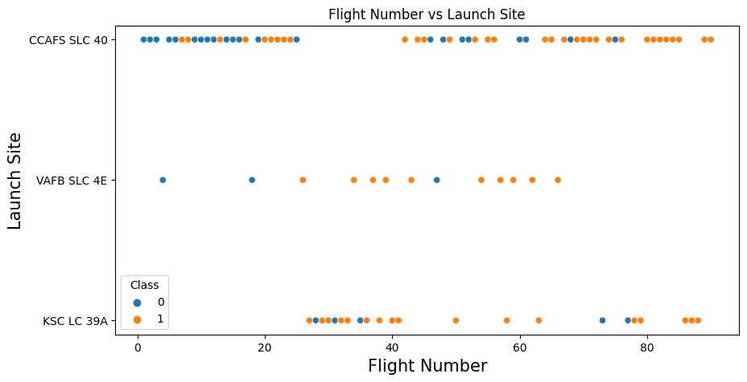
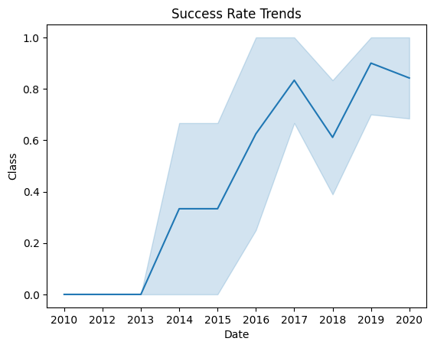
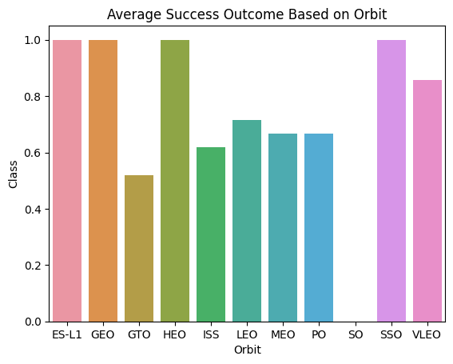
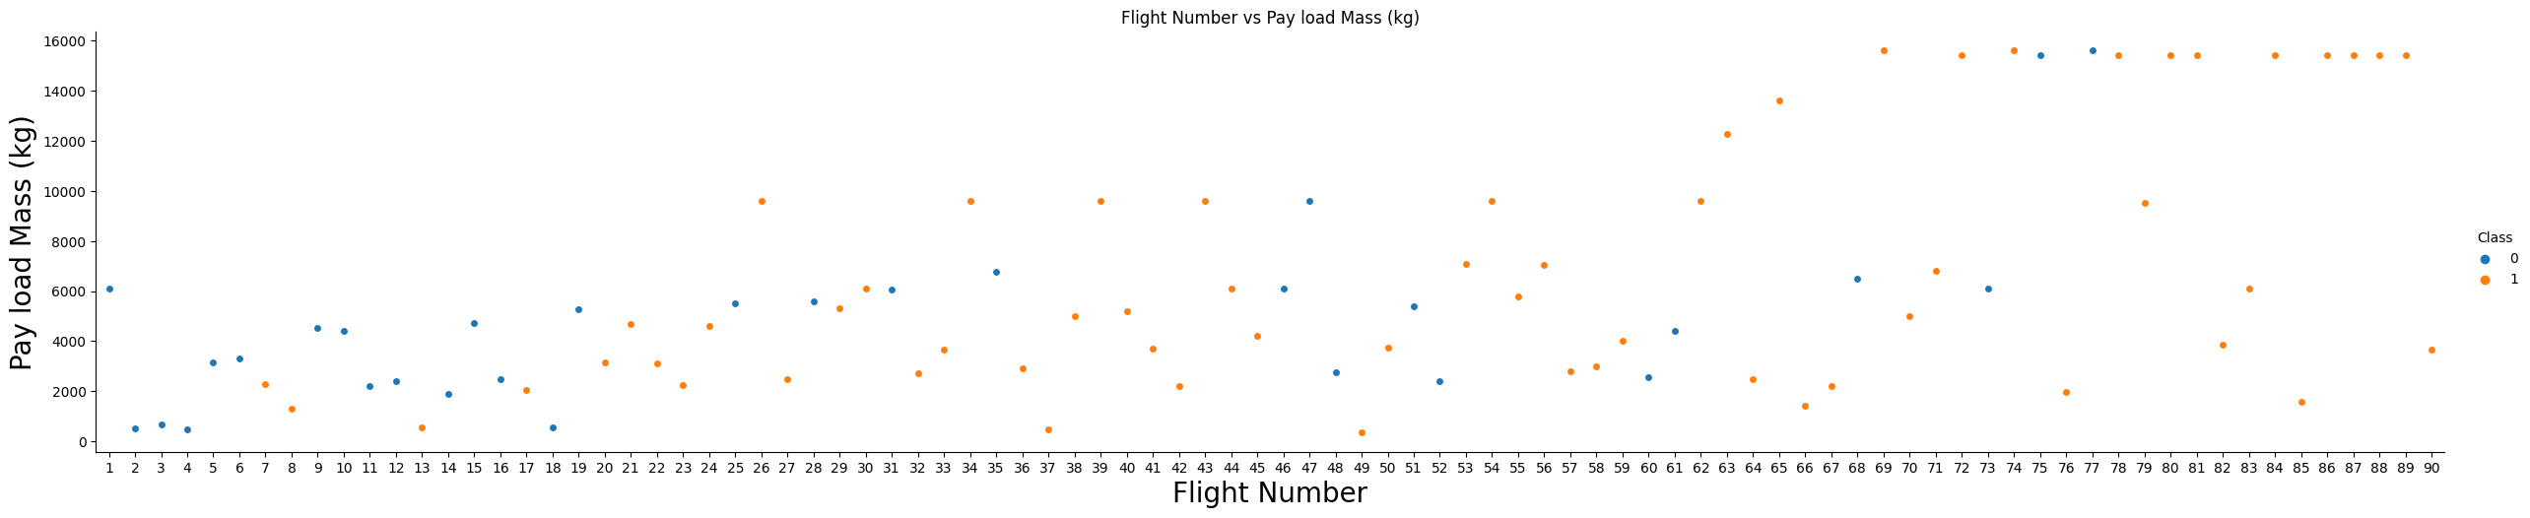
Results : EDA Visualization

Slide 9
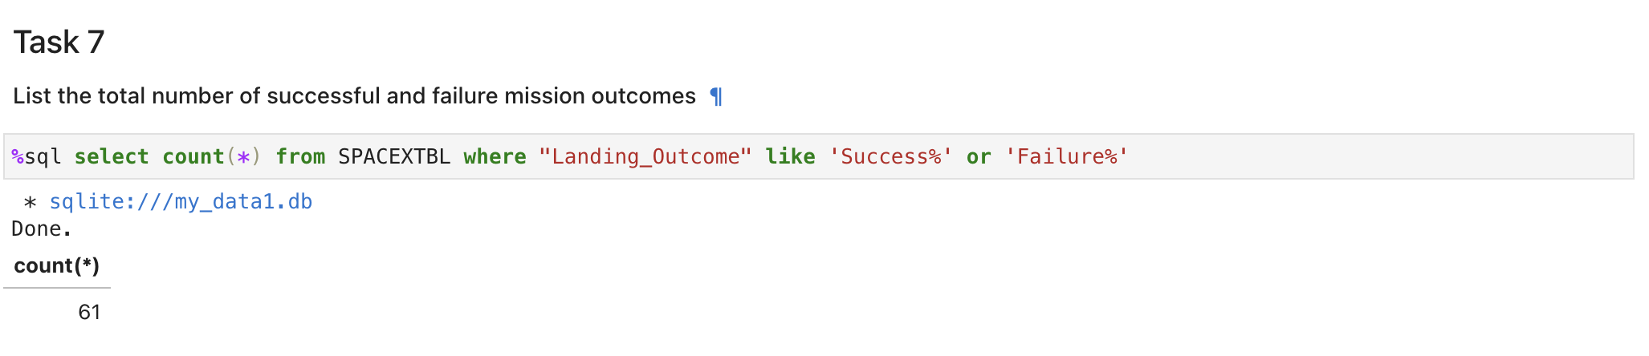
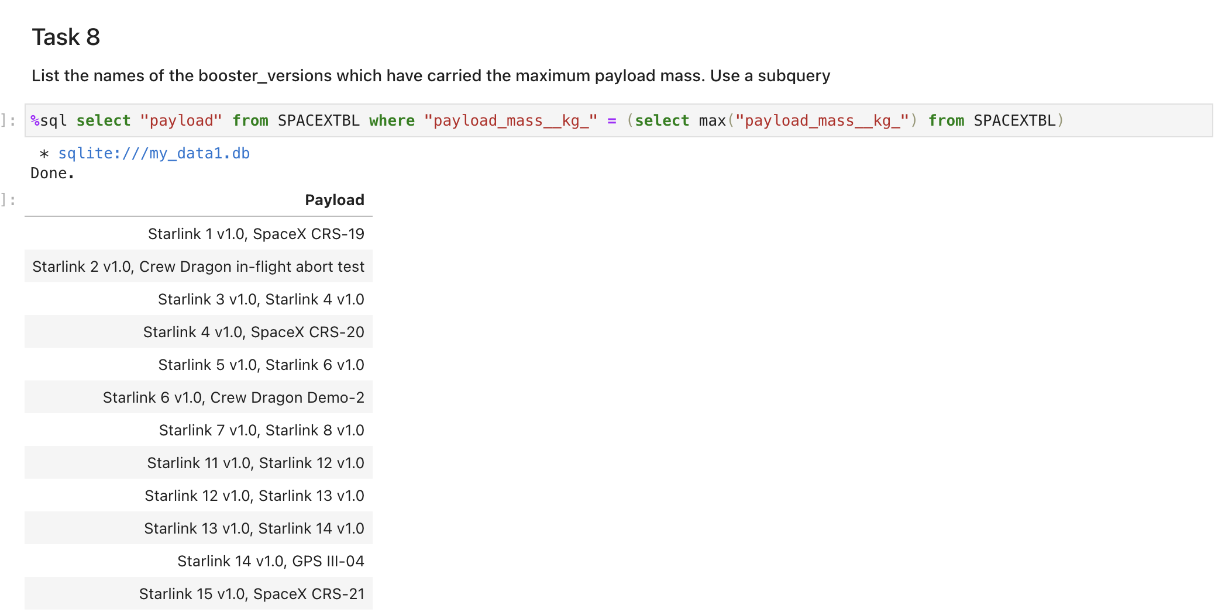
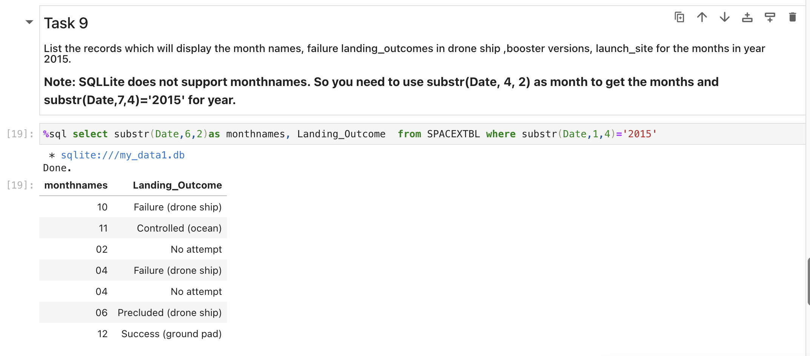
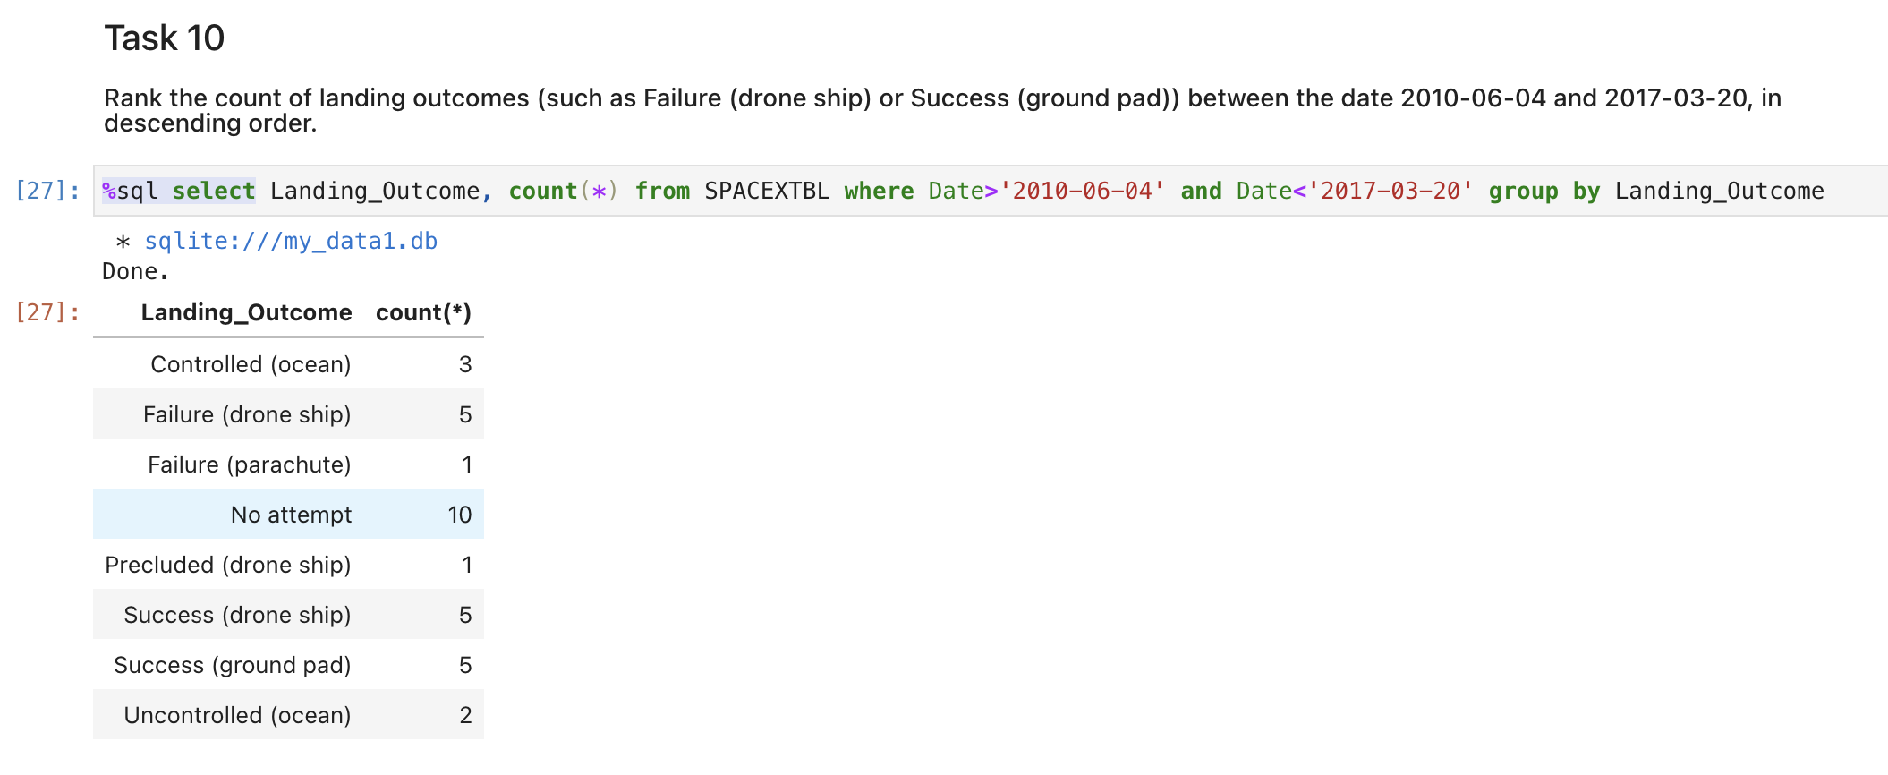
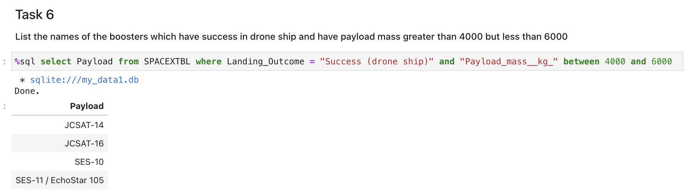
Results: EDA with SQL

Slide 10
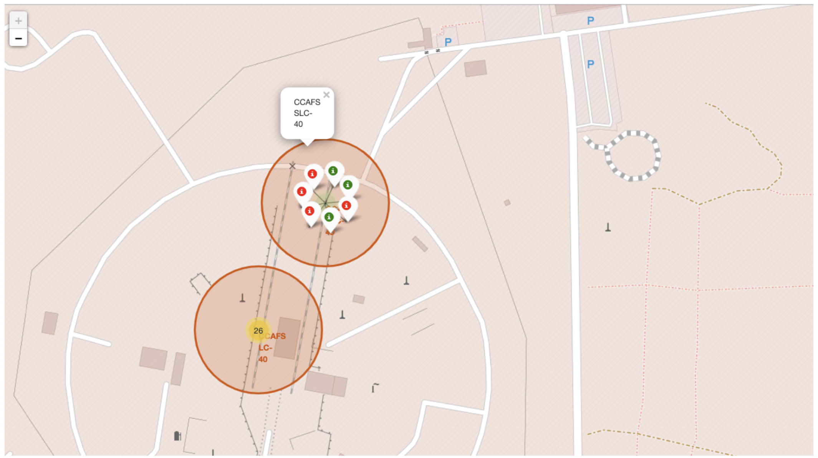
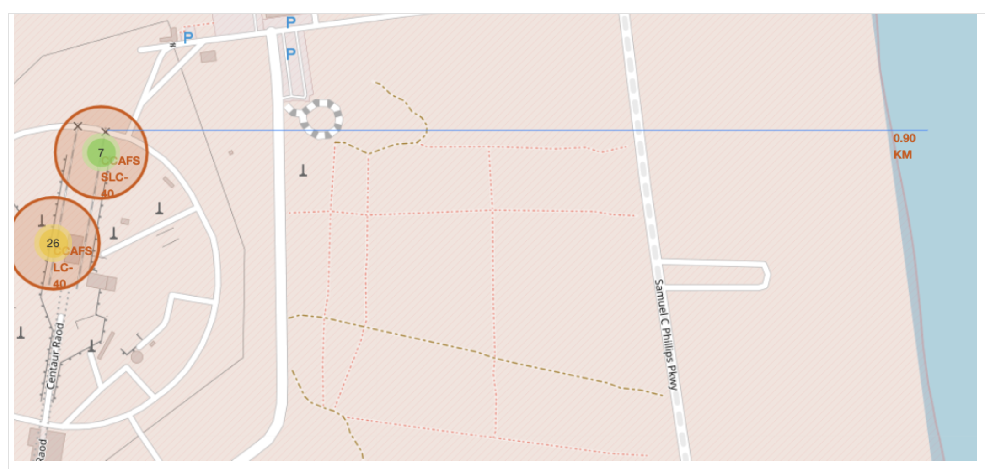
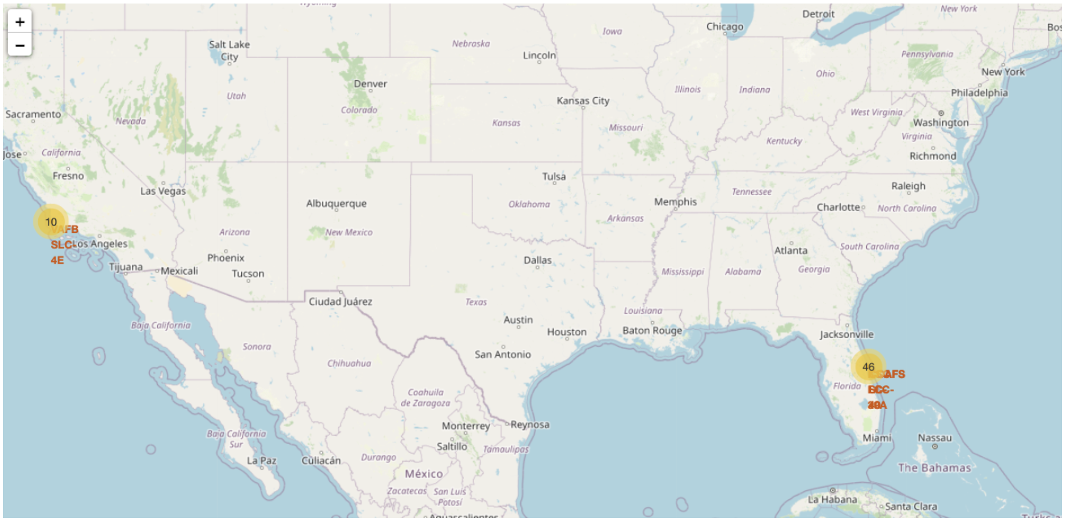
Result: Interactive Map with Folium

Slide 11
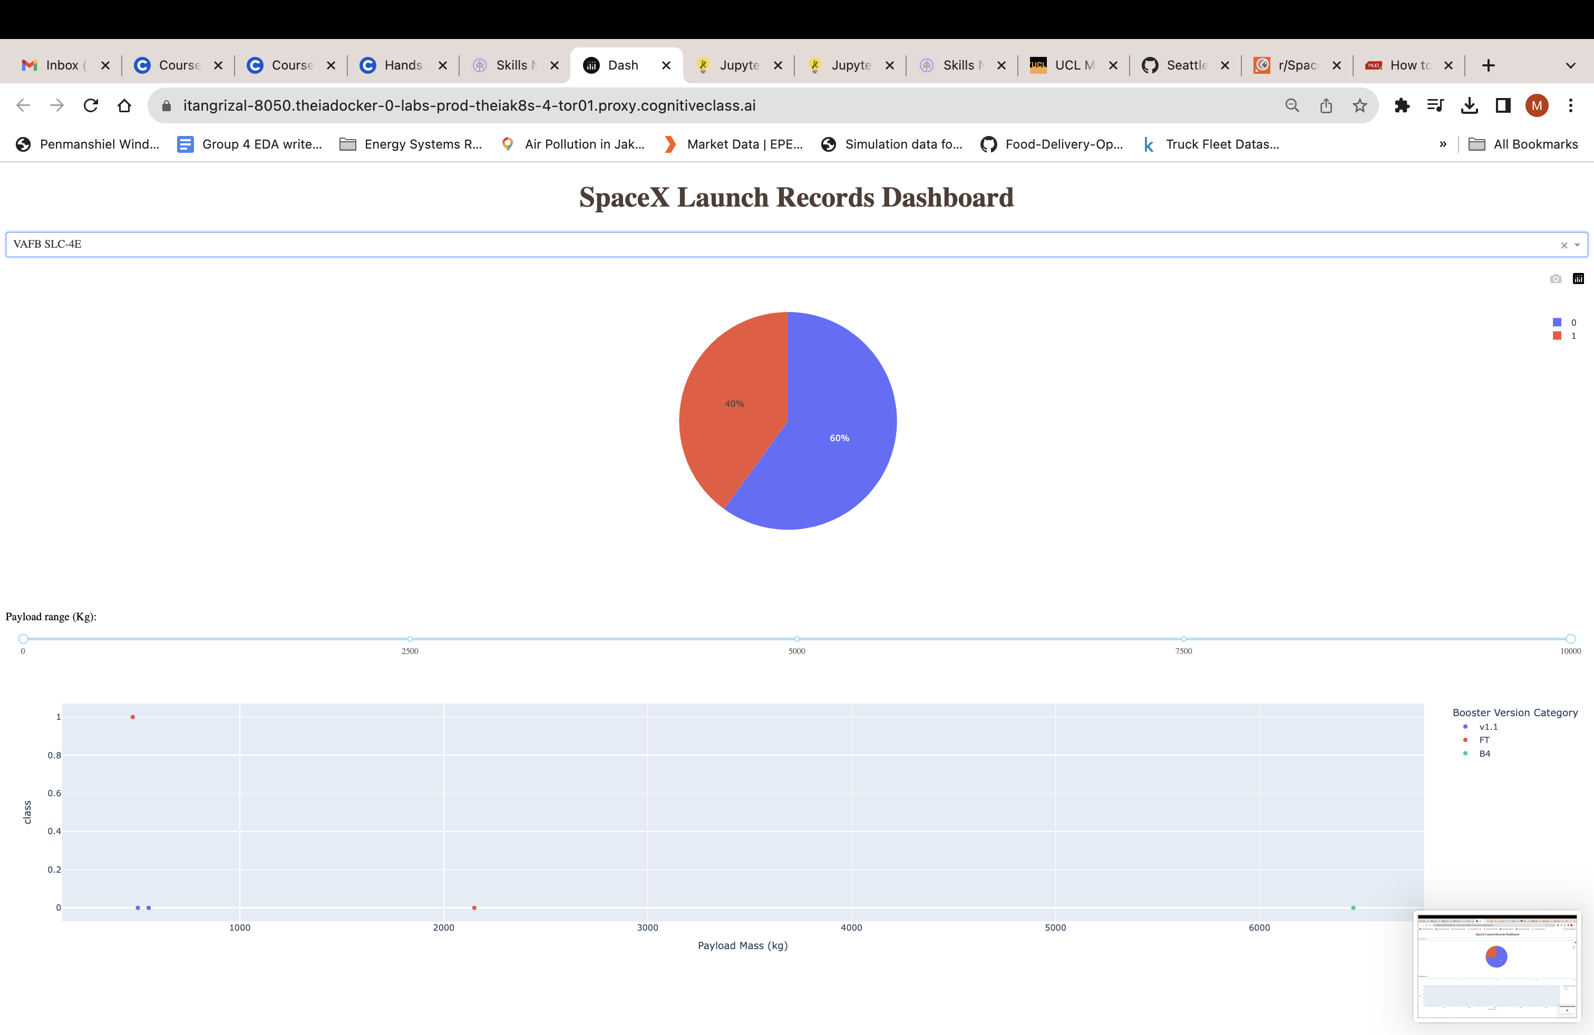
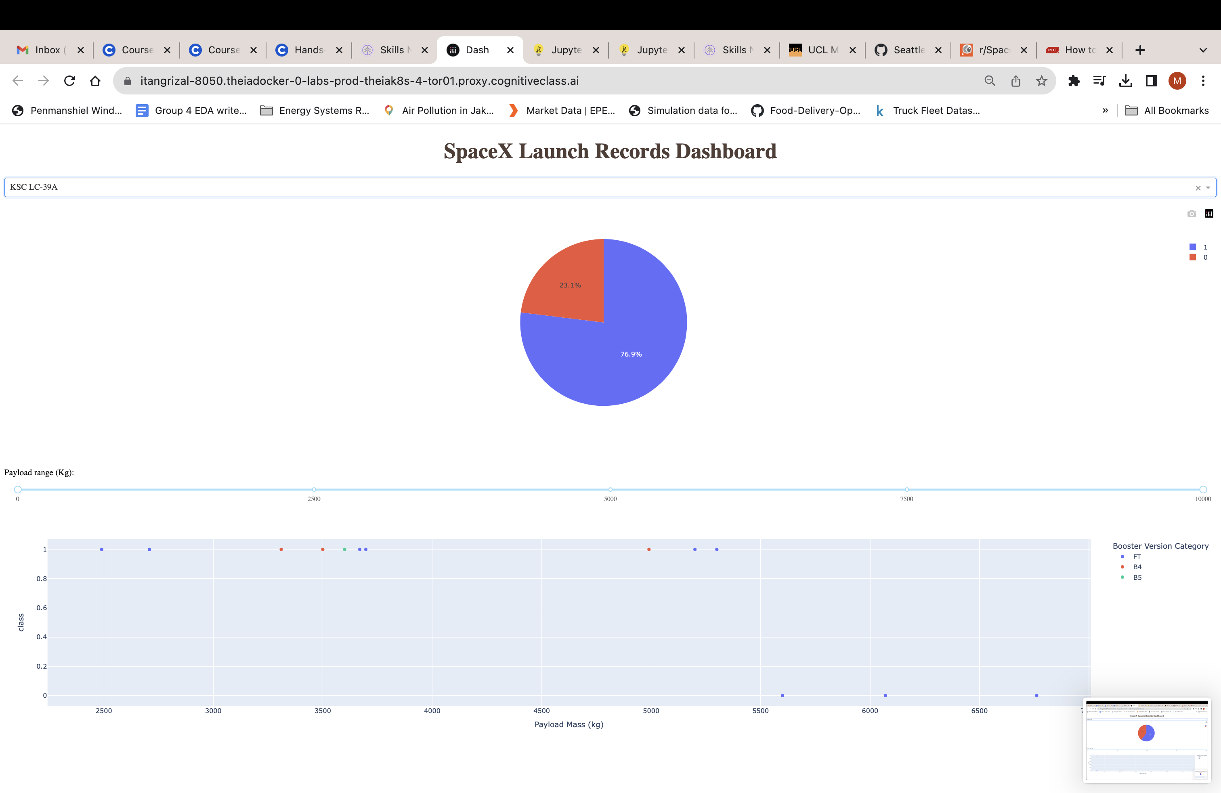
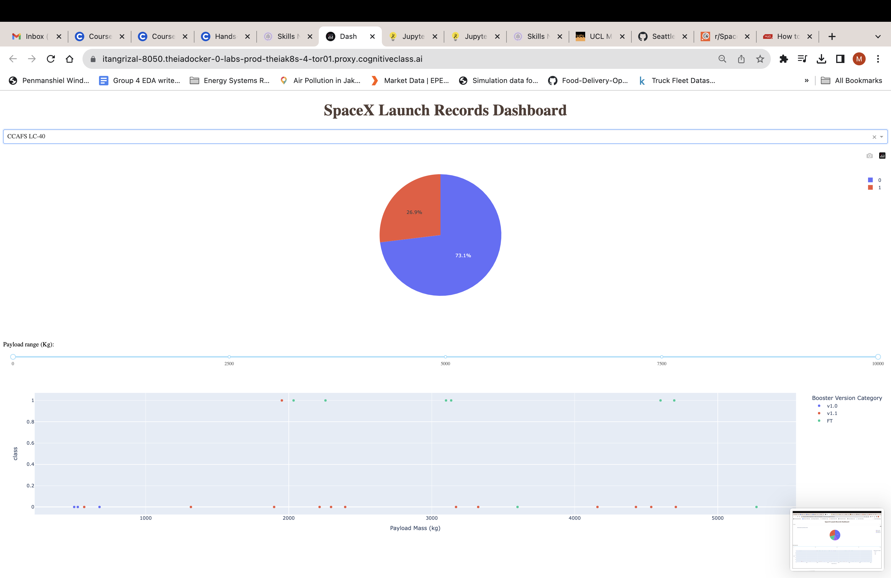
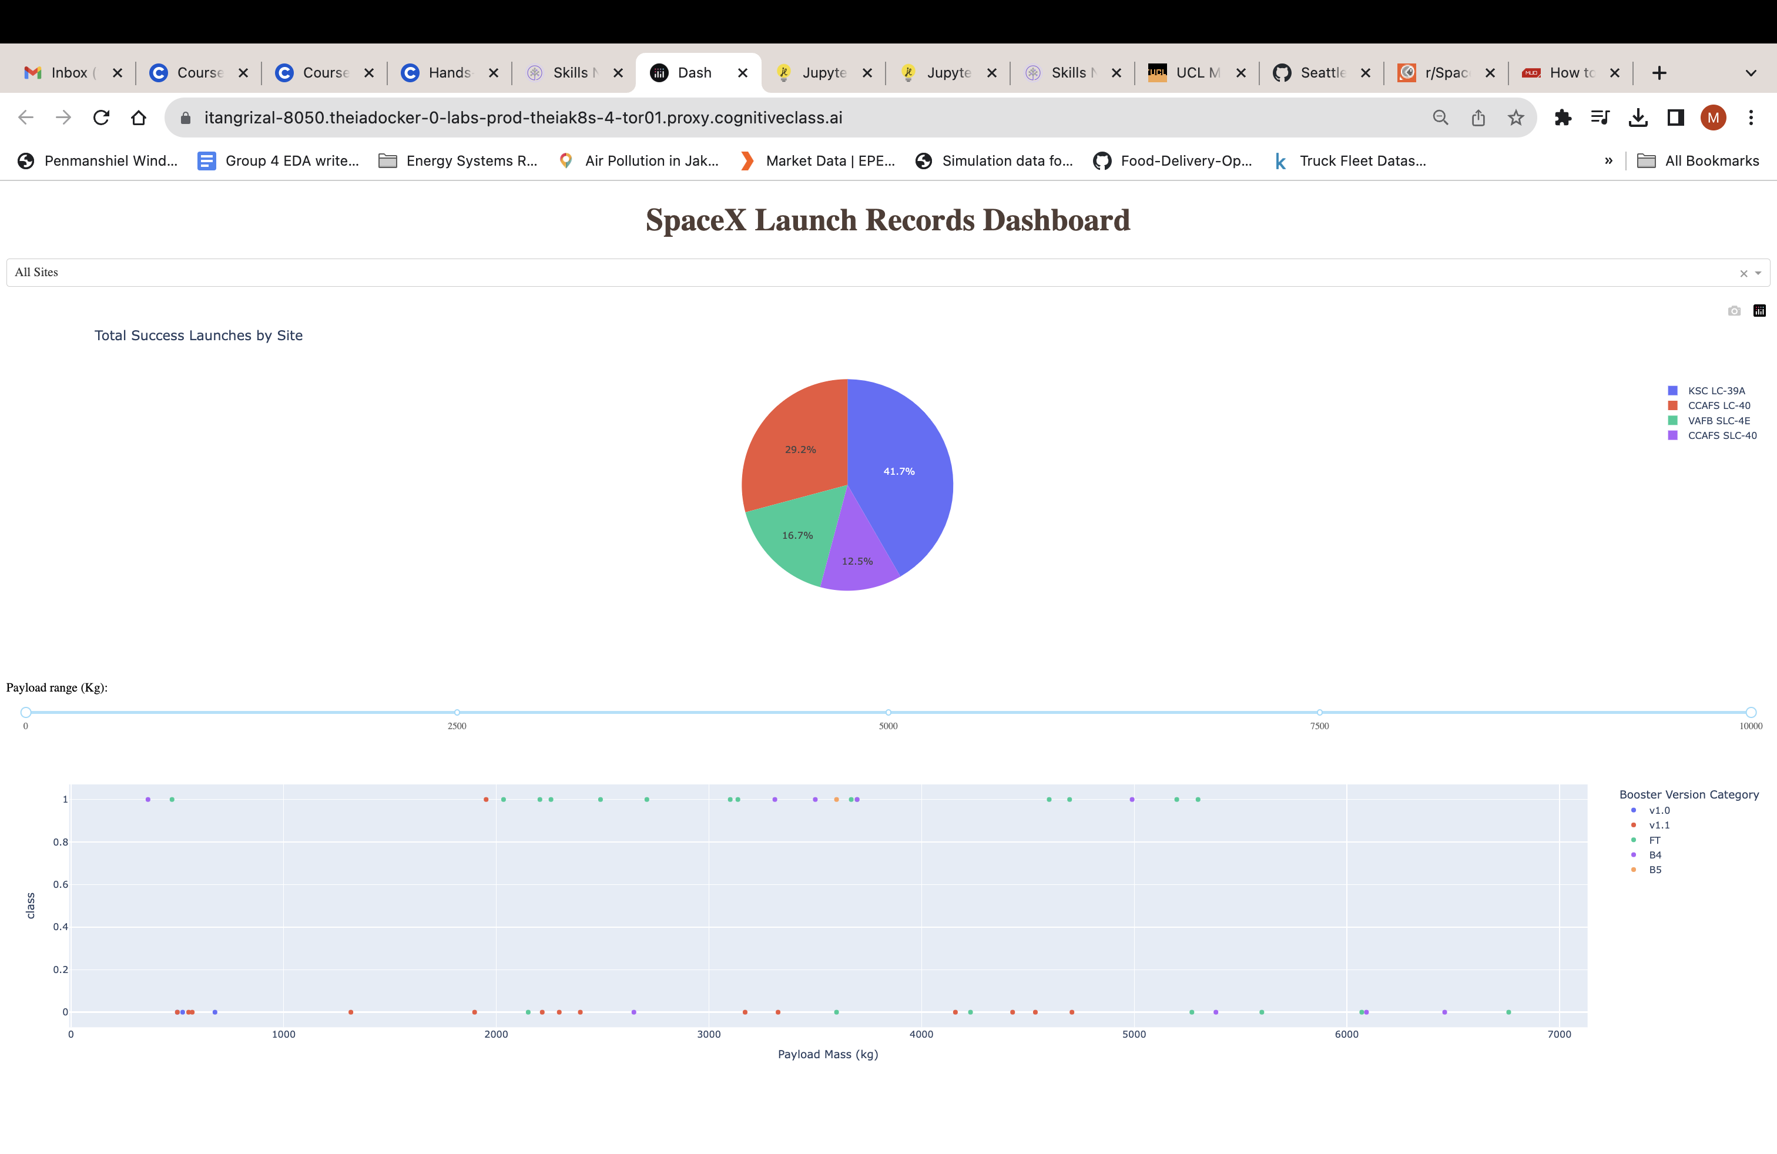
Plotly Dash Dashboard

Slide 12
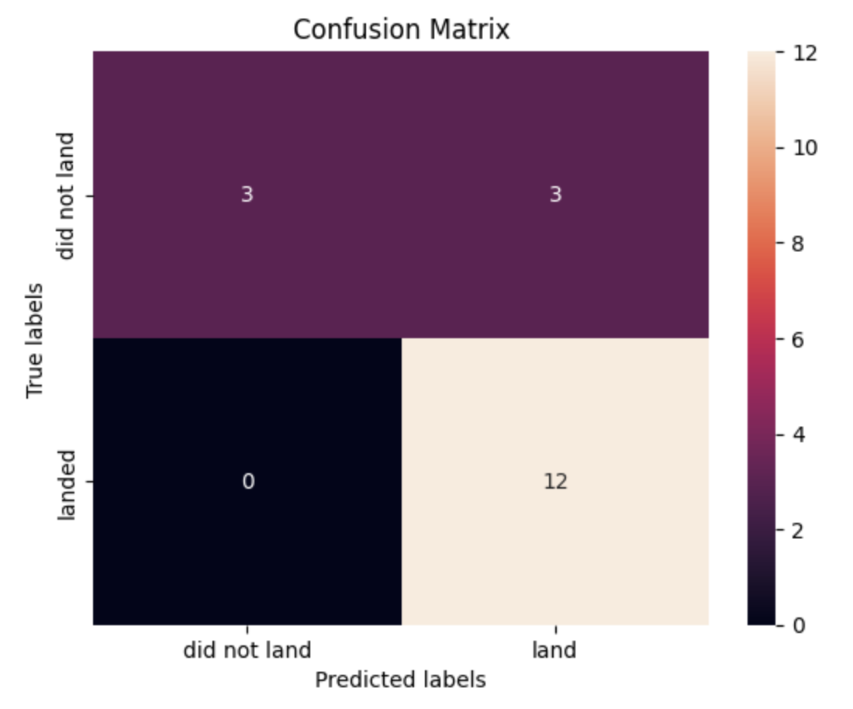
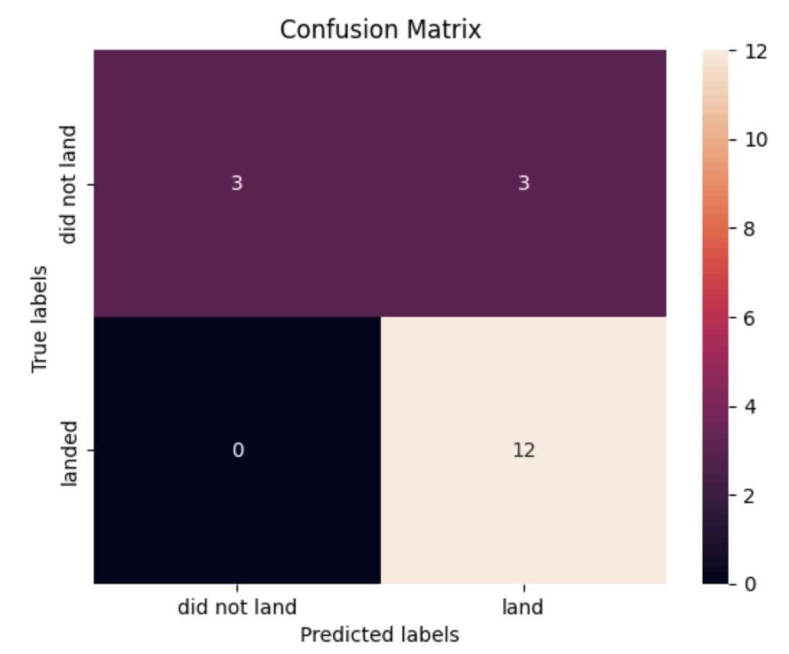
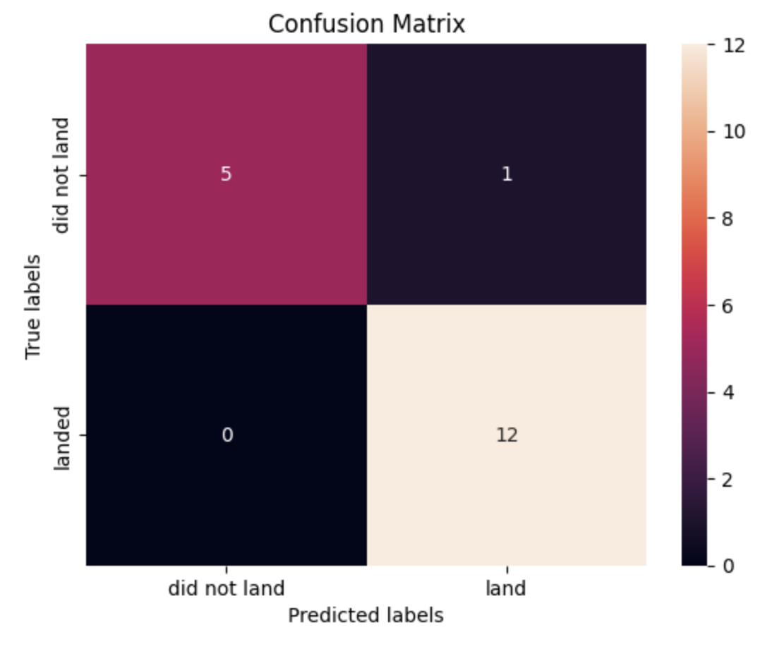
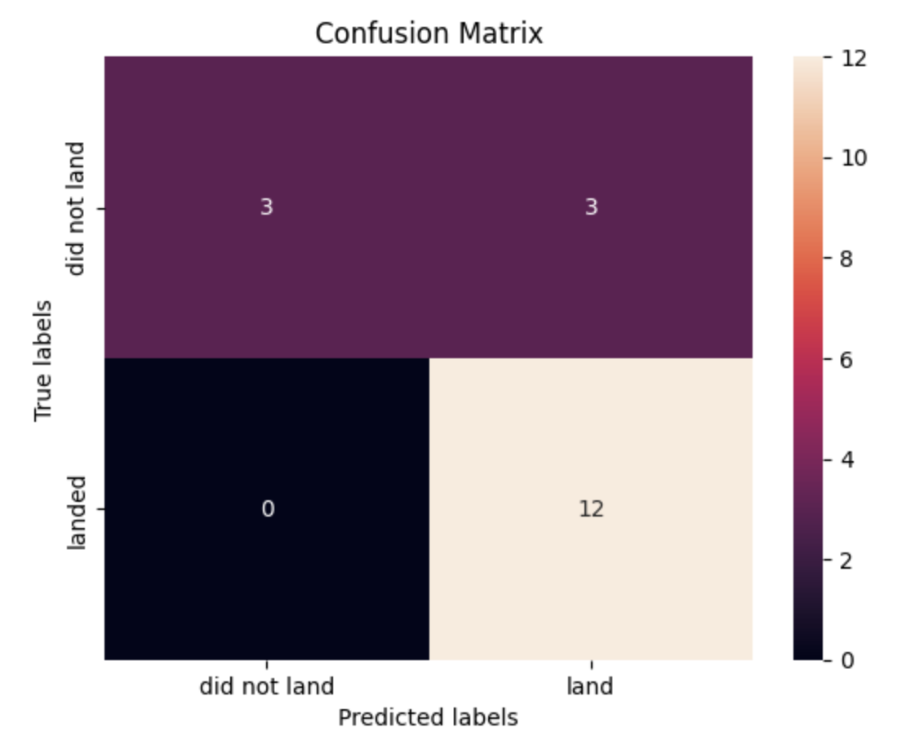
Results: Predictive Analytics
Logistic Regression
SVM
Model | Test Accuracy
Logistic Regression | 0.833
SVM | 0.833
Decision Tree | 0.944
KNN | 0.833
Decision Tree
KNN

Slide 13
Conclusions
Insights from EDA:
Success rate on first stage landing is increasing throughout the year and the amount of payload is also increasing.
CCAS SLC-40 has hosted the most rocket launches. However, the highest proportion of success rate in first-stage landing is located in KSC LC 39A
ES-L1, GEO, HEO and SSO Orbit Type have all of their first stage landed successfully with a rate of 100%.
There seems no relationship between increasing payload and the success rate of the first stage landing
Model Selection:
Decision Trees have the highest accuracy on predicting first-stage landing with an accuracy of 0.944

